Slide 1
Mapping Urban Economies Beyond National Histories. Spatial-Economic Organizations of Ottoman Neighborhoods in the Mid-Nineteenth Century
M. Erdem Kabadayı, Istanbul Bilgi University
Mapping and Visualising Transnational (Hi)Stories. Connecting History, Space and Digital Tools

Slide 2
Work in Progress
Preliminary results of a 3-year, (2012-2015),research project funded by the Scientific and Technological Research Council of Turkey (TUBITAK)
An Introduction to the Occupational History of Turkey via New Methods and New Approaches (1840 - 1940)
Project Nr. 112K271
Notes:
We have funding until October 2015
Two periods / two type of sources
TR almost done
INFORMATION ON THE PROJECT
This project analyzes changes in occupational structures and professions between the late Ottoman Empire and early Turkish Republic in the period of 1840 – 1940. It has an interdisciplinary perspective stemming from an interaction of economics, sociology and history by utilizing current developments in social sciences and especially in sociology of work and sociology of occupations. It focuses on history of occupations, which is an undeveloped subfield of economic history both in Turkey and abroad. The project investigates the historical developments of economic and social dynamics and causalities in the long run, which co-determine the emergence, development, decline and total or partial disappearance of occupations in Turkey.
The project, which will investigate the 100 years between the beginning of the Tanzimat reforms and the beginning of the World War II in meticulous detail, will focus on 3 reference years and on 3 respective main sources. 3 central analytical research questions corresponding to these years and sources are formulated as follows:
1844/45 Ottoman Registers of Income Yielding Assets (Temettuat Sayımları) (Temettuat registers are the results of one of the most detailed censuses ever made in the Ottoman Empire and possess rich detail on the Ottoman economy on household level. Occupations of heads of households are registered in very high percentages for numerous cities.)
Research Question: Which reactions did Ottoman artisanal production in major cities give to the radical changes in foreign trade policy and customs regime such as Anglo-Turkish Trade Treaty of 1838? What were the regional differences within these reactions and how did they affect city economies in particular and the Ottoman economy in general?
1927 Turkish Population Census (The first census of the Turkish Republic from 1927 contains occupational data on city and towns level for all of the 63 administrative centers of the country. If these data are compared to the occupational data aggregated from 1844/45 Temettuat registers, ruptures and continuities between the late Ottoman and early Republican economic life can be investigated in detail by analyzing the changes in occupational structures.)
Research Question: Which occupations, in which sectors and regions did decline and/or develop during the transition from the Ottoman Empire to the Turkish Republic?
1935 Turkish Population Census (The second census of the Turkish republic, which was conducted after the Great Depression of 1929, also possesses occupational data on the level of administrative centers. A comparative analysis of the datasets of occupational structures of 1927 and 1935 will make it possible to contrast not only the changes in the early Turkish economy but also the effects of external shocks and statist economic policies both on the city economies and on the national economy of Turkey in the period.)
Research Question: What are the regional and sectoral differences within the reactions given to an external shock such as of the Great Depression of 1929 by the economies of Turkish citiesi?
The occupational data, which are the main input of this project, are categorical and qualitative in their nature. Therefore, special methods of categorical data mining and correspondence analysis have to be employed to reach the set analytical goals. This is the reason why a specific methodology, which benefited from the latest developments in data mining and numerical analysis of qualitative data, has been chosen. The data will be processed by a technique and software designed and developed by Prof. Dr. Murat Güvenç, the director of the Center for Urban Studies at the Istanbul Şehir University.

Slide 3
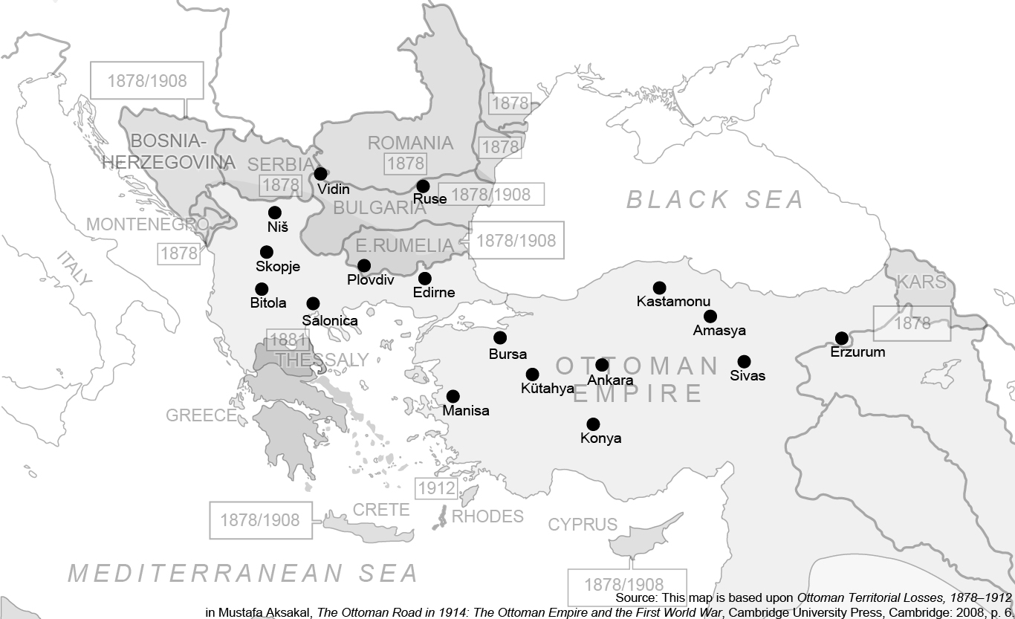
The Ottoman Empire in 1845

Slide 4
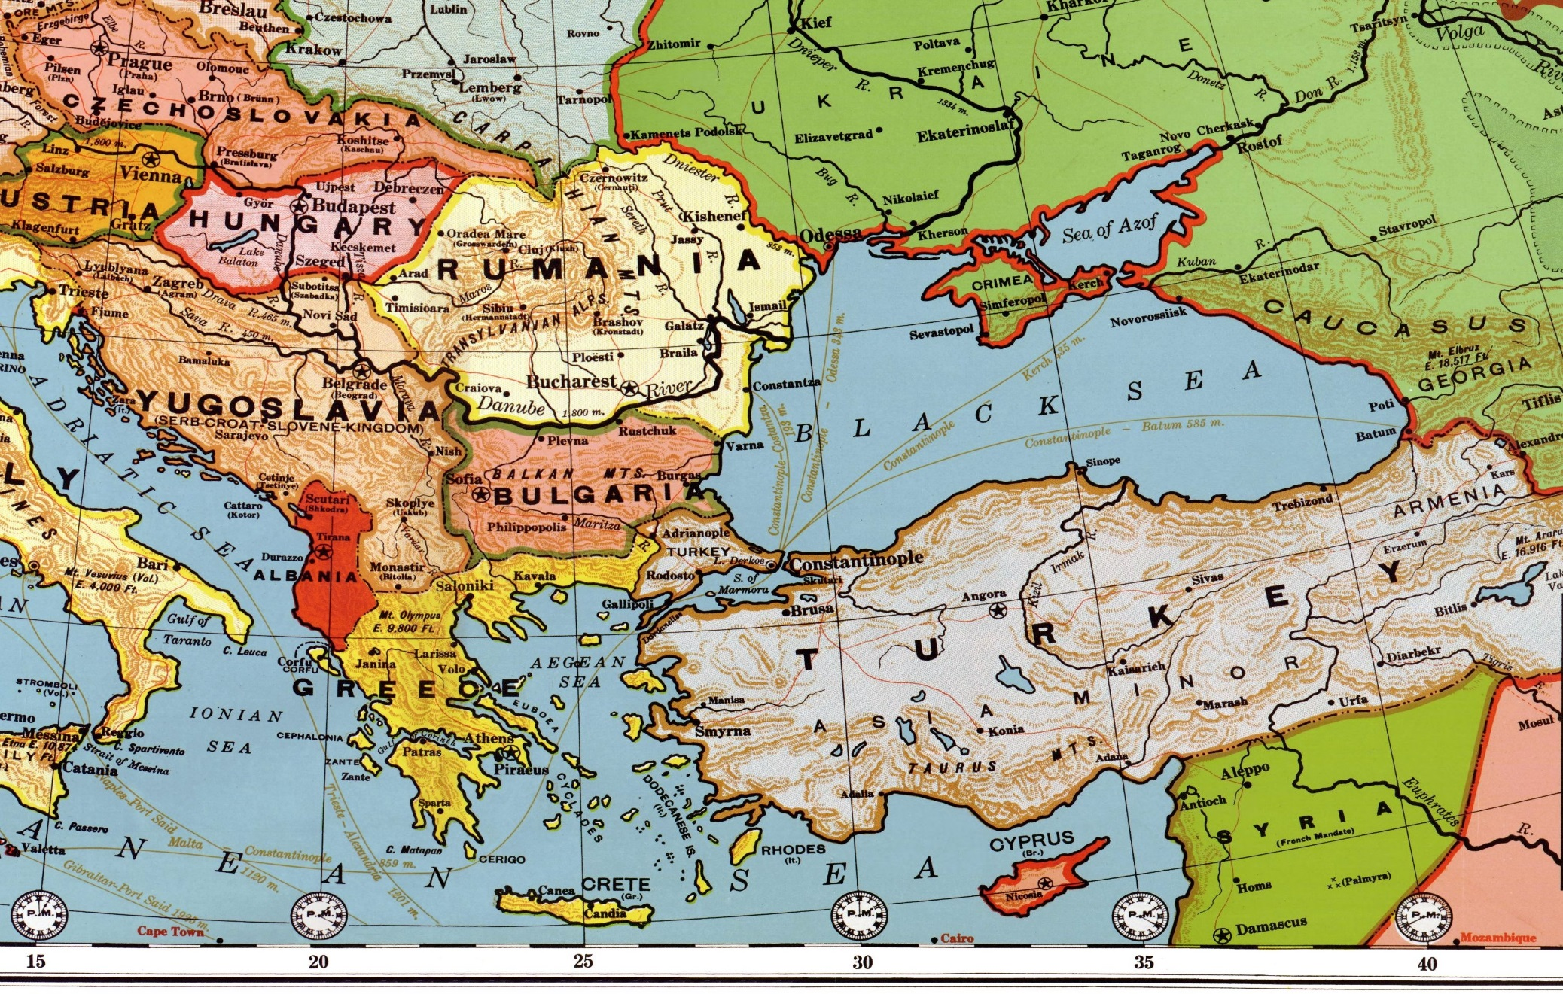
The Balkans and Turkey in 1923
Source: Bacon’s Standard Map of Europe

Slide 5
Ethno-religious Distribution of Household Heads, 1845
 | Salonica | Bursa | Ankara
Armenian |  | 1203 | 305
Catholic |  | 77 | 1530
Jewish | 2639 | 292 | 32
Roma | 48 | 19
Muslim | 1920 | 4212 | 3350
Protégé | 145
Orthodox Christian | 1566 | 689 | 516
TOTAL | 6318 | 6492 | 5733

Slide 6
Ethno-Religious Distribution of Household Heads, 1845

Slide 7
Mapping the Distributions of Occupational Categories,
Household Heads, 1845
 | Salonica | Salonica | Bursa | Bursa | Ankara | Ankara
Agriculture | 387 | 378 | 718 | 697 | 459 | 315
Industry | 1986 | 1976 | 2517 | 2255 | 2414 | 2000
Commerce | 1066 | 1060 | 724 | 629 | 588 | 478
Public Services | 225 | 225 | 467 | 438 | 308 | 255
Communication & Transport / Private Services / Liberal Professions | 1074 | 1072 | 635 | 589 | 382 | 313
No or Unknown Profession | 1580 | 1575 | 1431 | 1329 | 1586 | 1361
TOTAL | 6318 | 6286 | 6492 | 5937 | 5737 | 4722
Number of Neighborhoods | 70 | 70 | 145 | 129 | 96 | 73

Slide 8
Distributions of Occupational Categories,
Household Heads, 1845

Slide 9
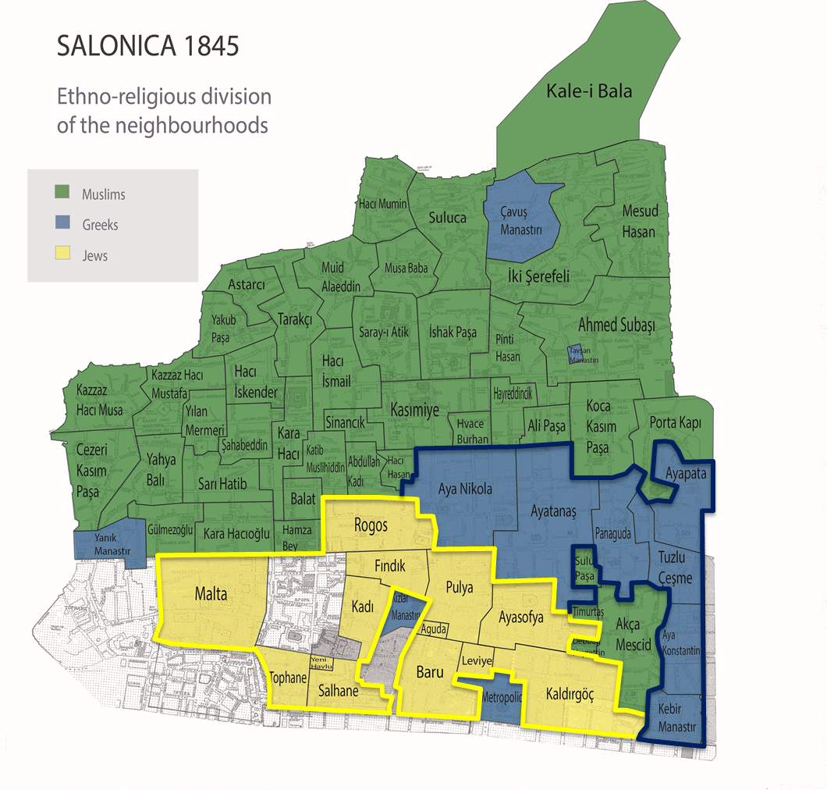

Slide 10
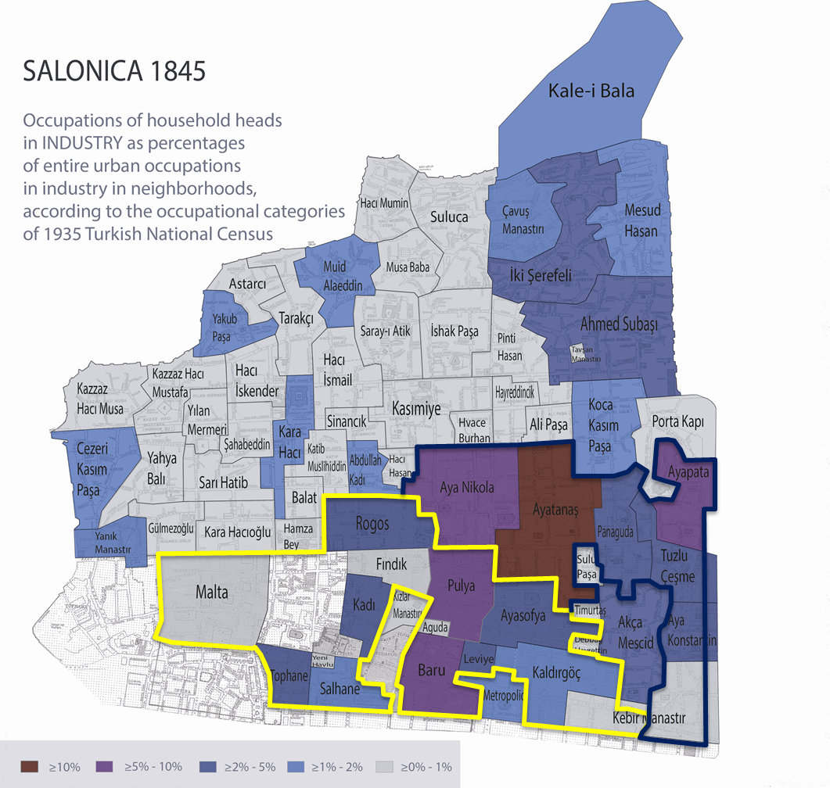

Slide 11
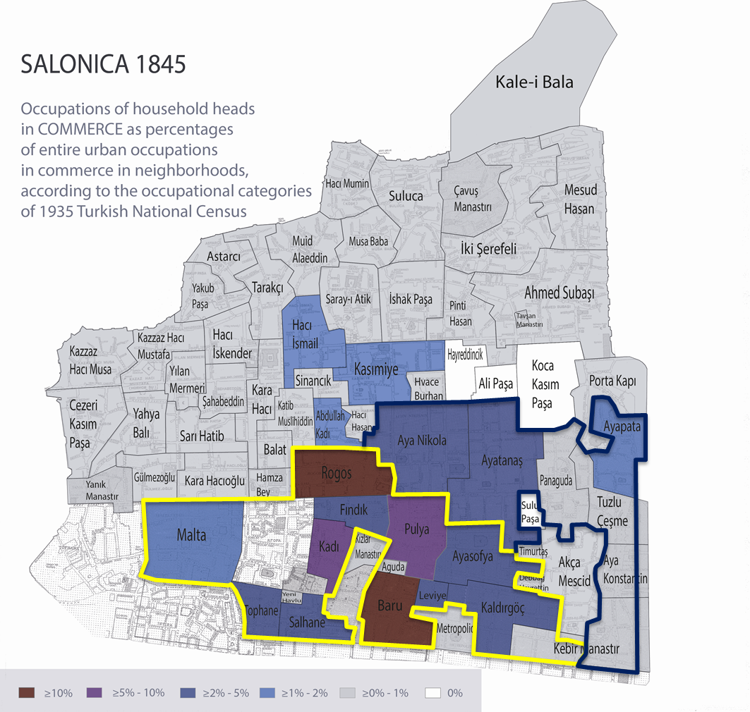

Slide 12
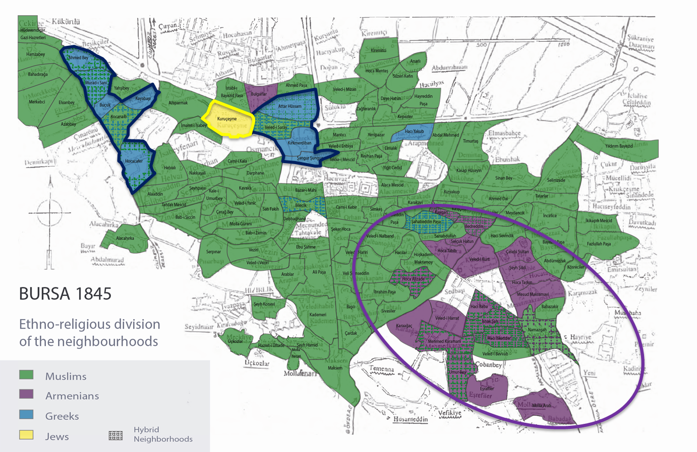

Slide 13
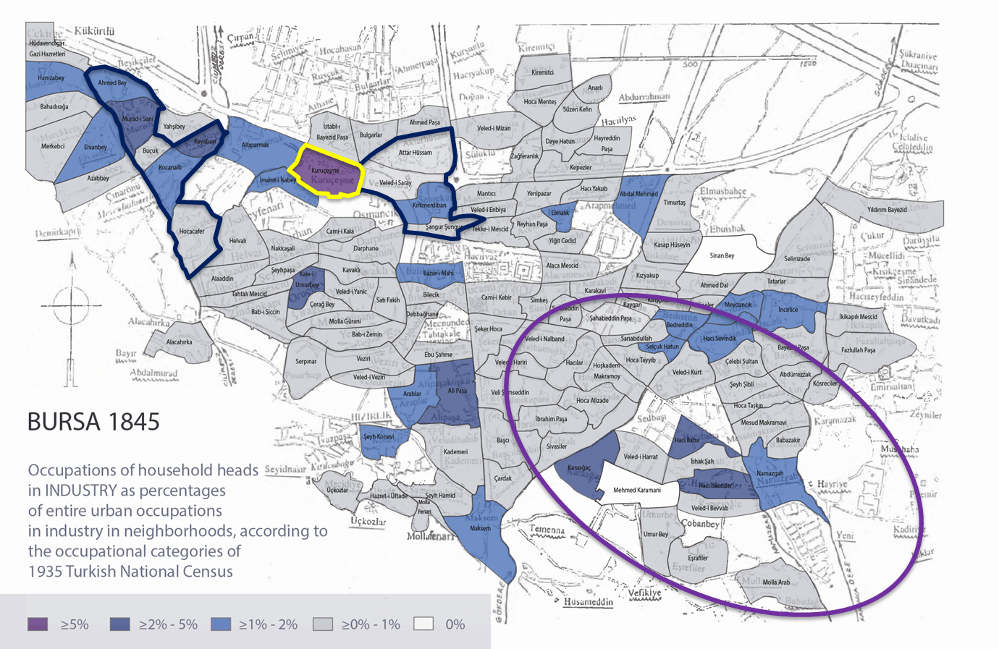

Slide 14
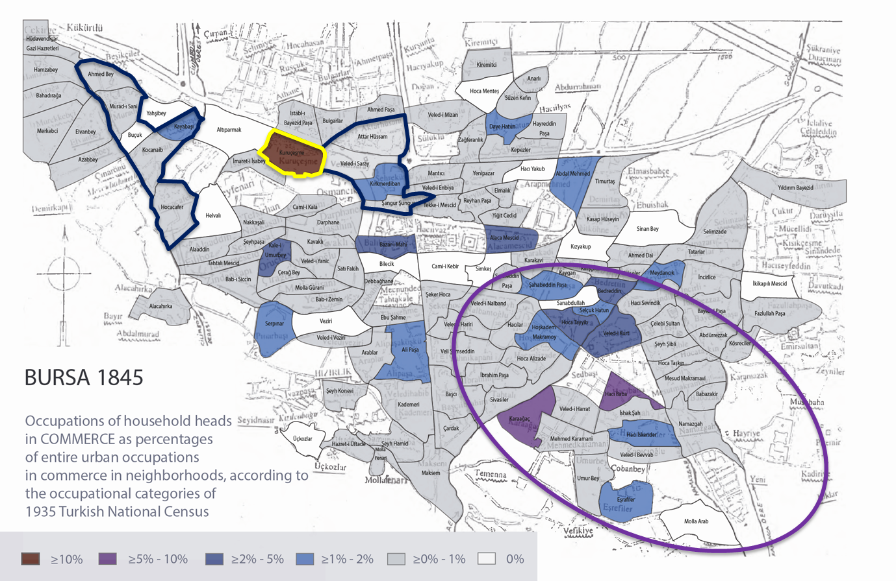

Slide 15
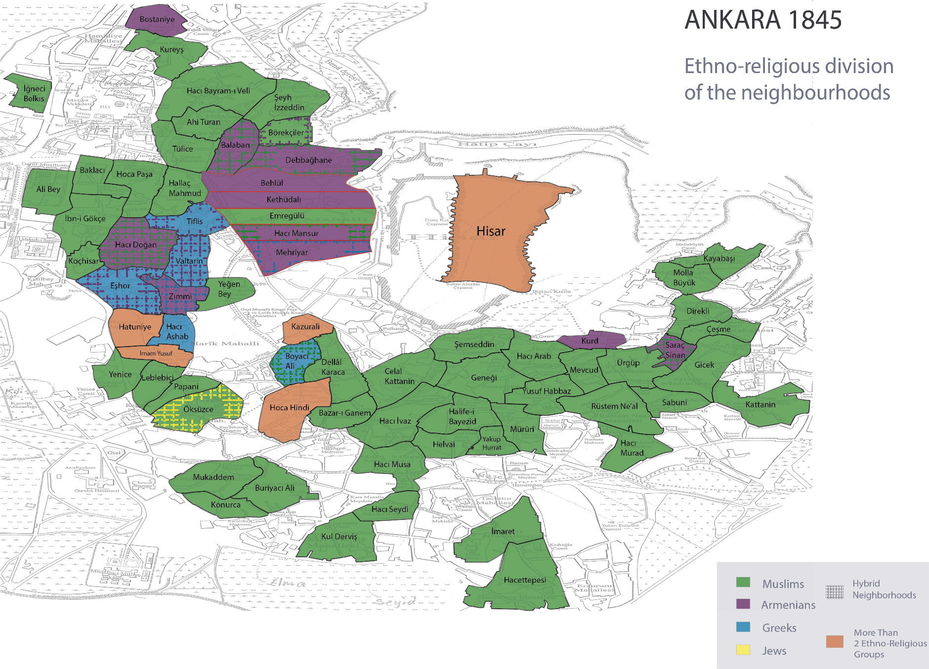

Slide 16
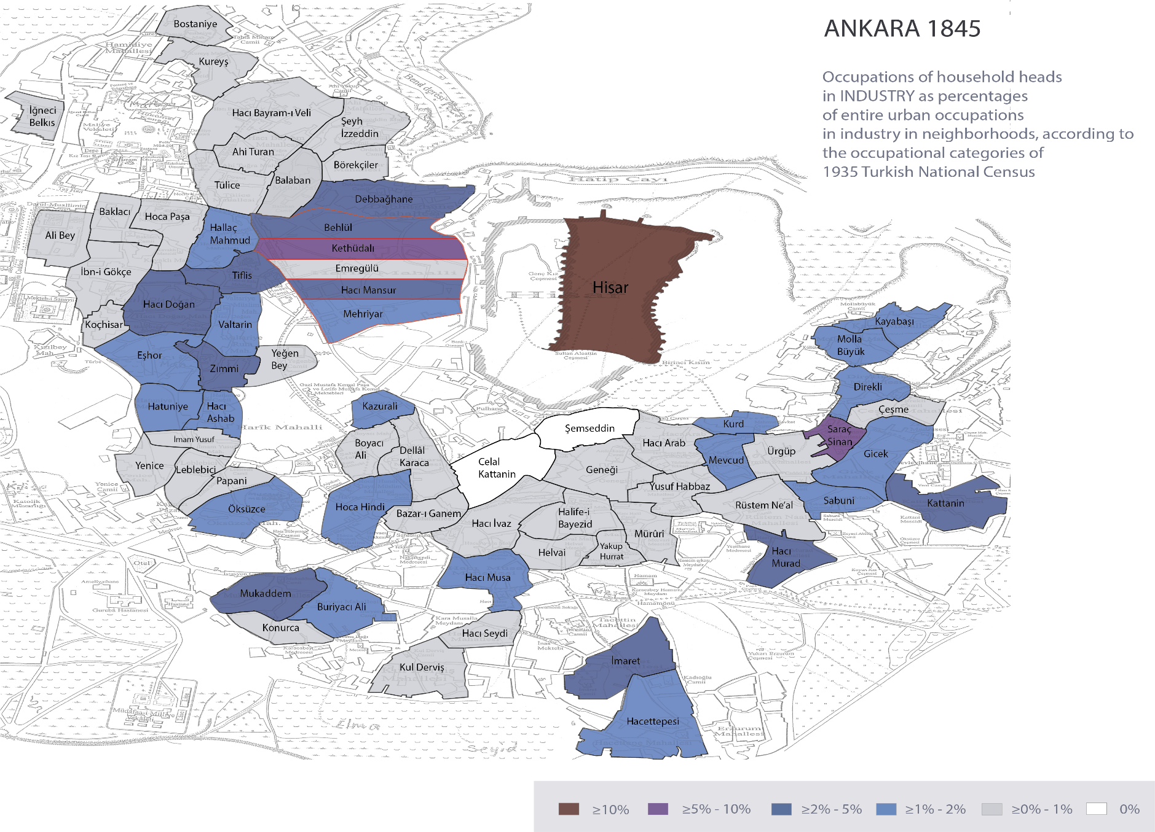

Slide 17
